Slide 1

The Role of CCIC in Meat Export to China
——We certify and verify for compliance !
CAO Yabin
General Manager, CCIC Kelet-Európai KFT

Slide 2
1. Memorandum of Understanding
2. General Administration of Quality Supervision, Inspection and Quarantine of the People’s Republic of China (AQSIQ)
3. China Certification & Inspection Group Company (CCIC)
4. CCIC East Europe Co. Ltd/CCIC Kelet-Európai KFT
5. Regulation and administration on import food
6. Steps and procedures
7. What can we do for you?
Main Contents

Slide 3
Memorandum of Understanding
Memorandum of Understanding
between AQSIQ /CNCA and the Prime Minister’s Office, Secretariat of the Government Commissioner for the Coordination of Hungarian-Chinese Bilateral Relations
regarding the establishment of a local branch office of CCIC in Hungary
was signed on November 13th, 2013 by Mr. Péter Szijjártó , State Secretary for External Economic Relations and Foreign Affairs and Mr. Sun Dawei, Deputy Minister of AQSIQ.

Slide 4
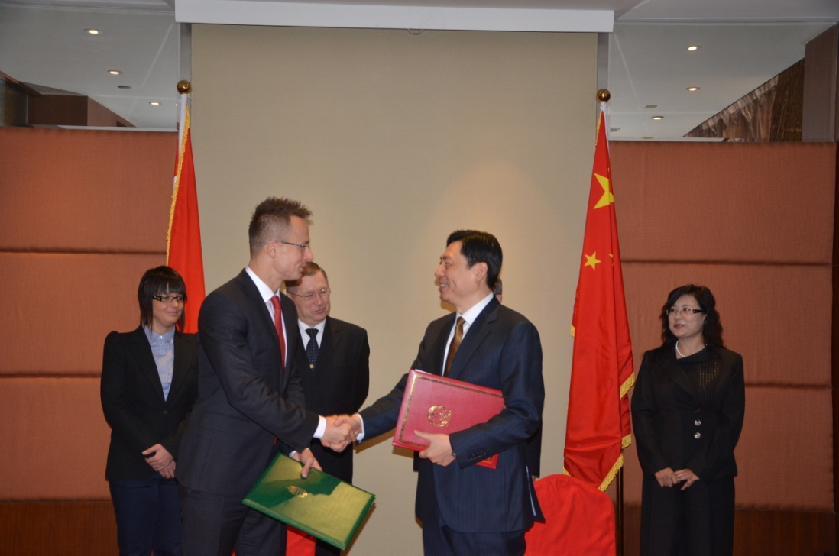
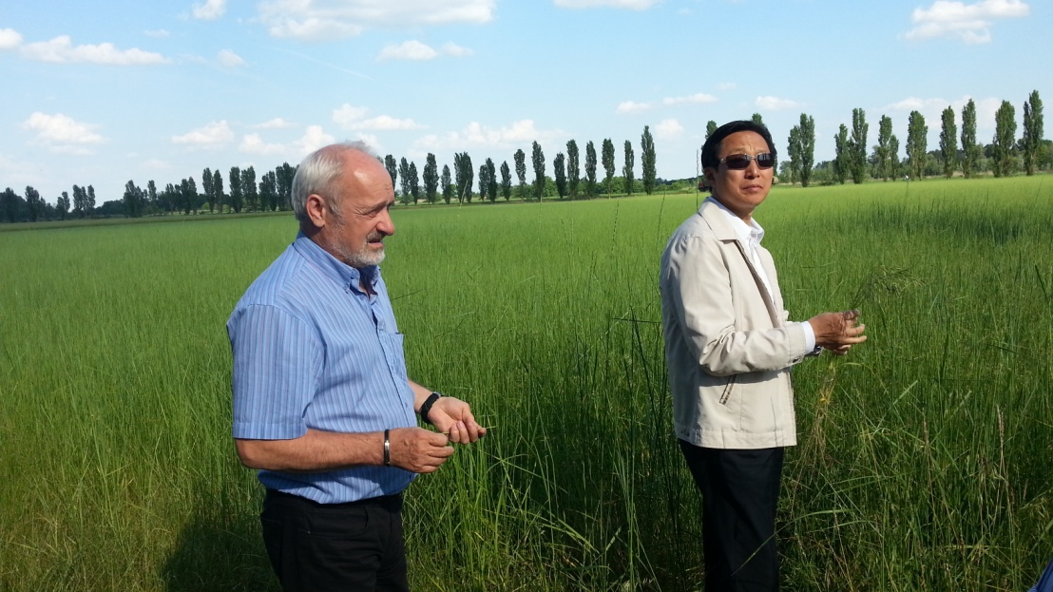
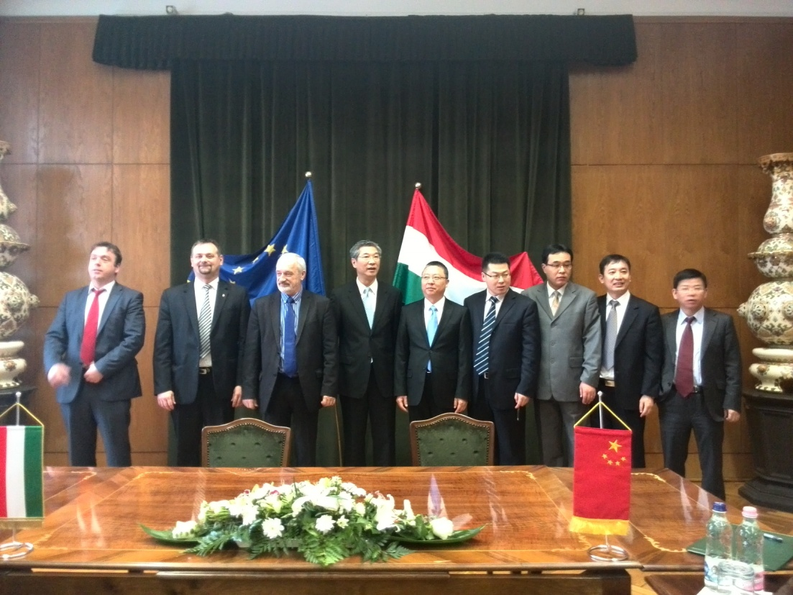
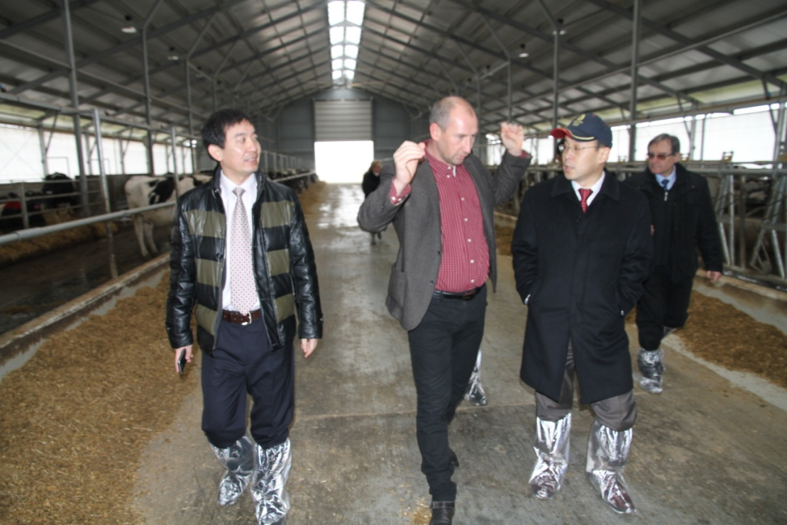

Slide 5
AQSIQ and CNCA
General Administration of Quality Supervision, Inspection and Quarantine of the People’s Republic of China (AQSIQ) is a law enforcement Ministry in charge of:
Quality supervision
Metrology
Import and export commodity inspection
Animal and plant quarantine
Health quarantine
Certification and accreditation
Standardization
Certification and Accreditation Administration of the People's Republic of China (CNCA)
Under AQSIQ
Factory inspection and permission of food plants

Slide 6
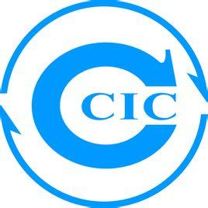
CCIC
China Certification & Inspection Group Company (CCIC) is a certification and inspection body dedicated to providing inspection, certification and testing services under authorization and accreditation from AQSIQ and CNCA
We certify and verify for compliance!
Comprehensive service provider for international clients in the fields of quality, safety, health and environment.
Ongoing efforts to provide clients with impartial, efficient, reliable, standardized and localized services.

Slide 7
CCIC East Europe Co. Ltd/CCIC Kelet-Európai KFT
Establishment and mission:
Established according to the agreement between the relative government organizations of Hungary and China.
Serve as a liaison office between AQSIQ and relative Hungarian Ministries, such as Rural Development.
Focusing on inspection, testing, verification and certification of import and export products.
Help local manufacturers and exporters meet relative market entrance requirements and facilitate international trade.

Slide 8
CCIC East Europe Co. Ltd/CCIC Kelet-Európai KFT
Services we provide:
Providing information regarding regulation and procedures issued by the relevant Chinese government authorities.
Market entrance assistance and consultancy.
Testing, inspection, verification and certification services for export product (including food and non-food product) and manufacturers.

Slide 9
China’s Regulation and Administration System on Import Food
In line with internationally prevailing practices, China has established a integrated import food safety surveillance system based on respective measures such as risk analysis, registration of foreign manufacturers, import permit, filing of importer/exporter, etc.
Law and regulation bases:
Food Safety Law and its Implementation Regulations
Law of Entry-exit Plant and Animal Quarantine and its Implementation Regulations
Law of Import and Export Commodity Inspection and its Implementation Regulations

Slide 10
Regulations, Rules and Procedures Issued by AQSIQ
Control Measures on Safety of Import and Export Food
Establishing an overall management system on safety of import food, including: food safety management system assessment and risk analysis, inspection and quarantine standard, inspection and registration of foreign manufacturers, filing of exporters and their agents, import permit, on-spot inspection and quarantine at the port, safety monitor and alarm, food recall, etc.
Specific regulations on respective products：
Control Measures for Inspection and Quarantine of Import and Export Meat
Control Measures for Inspection and Quarantine of Import and Export Aquatic Products
Control Measures for Inspection and Quarantine of Import and Export Milk Products

Slide 11
Steps towards Actual Food Export
General principle:
Import food shall be in conformity with relative Chinese food safety standard and inspection or quarantine requirements.
Heath and hygiene standards
Chinese label
Packaging
Close cooperation between government organizations and manufacturers is needed.
Government agreement
Official health certificate
Notes:
Imported meat products must come from non-epizootic disease countries or regions.

Slide 12
Steps towards Actual Food Export (cont’d)
AQSIQ conducts assessment on the food safety management system and food safety situation in the export country.
AQSIQ determines and issues inspection and quarantine requirements or sign an agreement with the export country on the basis of Chinese regulation and standard, epizootic condition and risk analysis on toxic and hazardous substances, taking into account of assessment and inspection result.
CNCA carries out registration of foreign food manufacturers.
AQSIQ shall put on record all trade dealers (exporter/importer or their agents).
The importer shall get an import permit for the import food subject to import permit requirement.
Local CIQs conduct routine inspection and quarantine on import food at the port.
AQSIQ may request pre-shipment inspection in the export country.
Notes:
Imported meat products must come from non-epizootic disease countries or regions.

Slide 13
Different Scenarios
Meat and processed meat product
Pre-conditional market entrance procedure on both Government level and manufacturer level
Labeling and quality conformity requirements for product to China
Shipment documents and formalities to be finished by the exporter and importer
Spot check at destination and Post-market surveillance in the domestic market
Ordinary pre-packaged food
Without pre-conditional market entrance requirements
Labeling, spot-check and market surveillance requirements apply
Food for special dietary use: health and nutrition products
Additional permission from Food and Drug Administration Authority
Notes:
Imported meat products must come from non-epizootic disease countries or regions.

Slide 14
What can we do for you?
Market entrance consultancy and assistance: consultancy on market entrance process, assistance on export process and post-market surveillance.
Supplier assessment and evaluation: make evaluation on the supplier’s facilities or product, on behalf of the government authority or buyer or simply as a third party, to show conformity or build up confidence.
Testing and inspection: pre-shipment inspection, loading and shipment monitoring, full-item testing on food product according to Chinese Standard and providing report as proof of conformity and technical support for Health Certificate.
Food label and traceability: food label in Chinese, food chain traceability verification and certificate of origin.

Slide 15
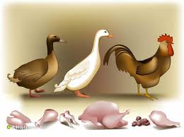
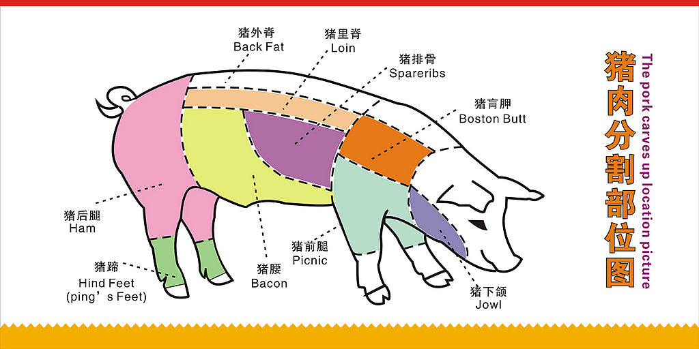


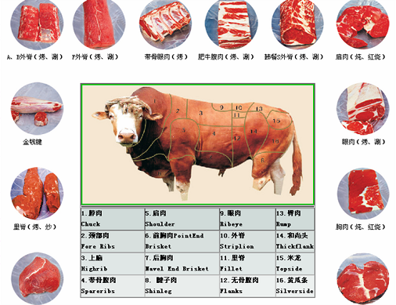
What’s going on?

Slide 16
Thank you for your Attention!
CAO Yabin
General Manager, CCIC Kelet-Európai KFT
H-1133 Budapest, Váci út 76, Capital Square, 1. épület, 3. emelet
Tel: 06-1-8830440
Fax: 06-1-8830301
Mobile: 06-702212636
Email: caoyabin@gmail.com

