Slide 1
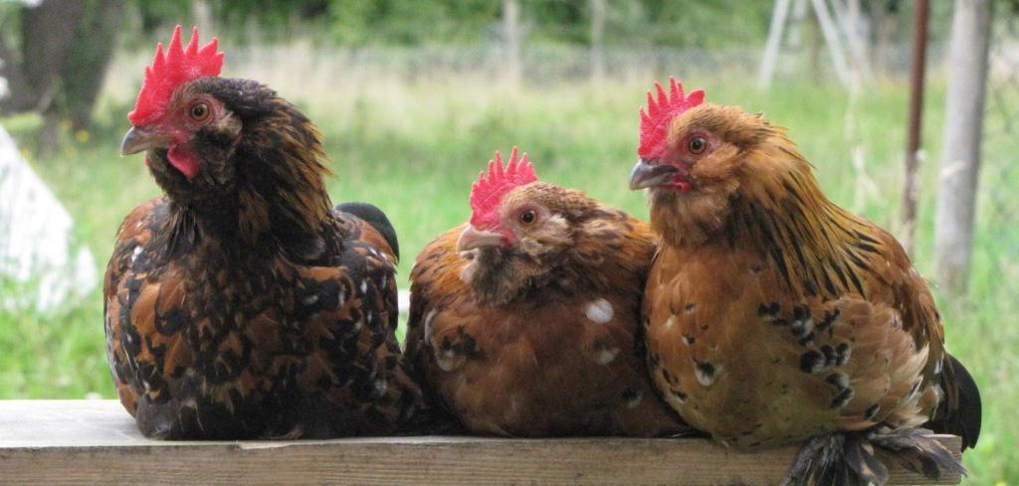
EU Market Situation for
Poultry
Committee for the Common Organisation of the Agricultural Markets
8 November 2018

Slide 2
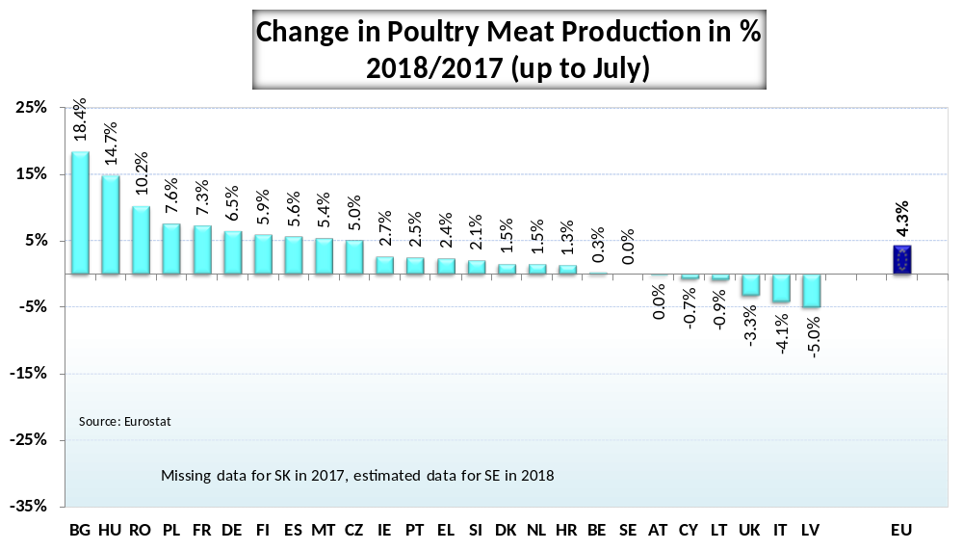
P R O D U C T I O N

Slide 3
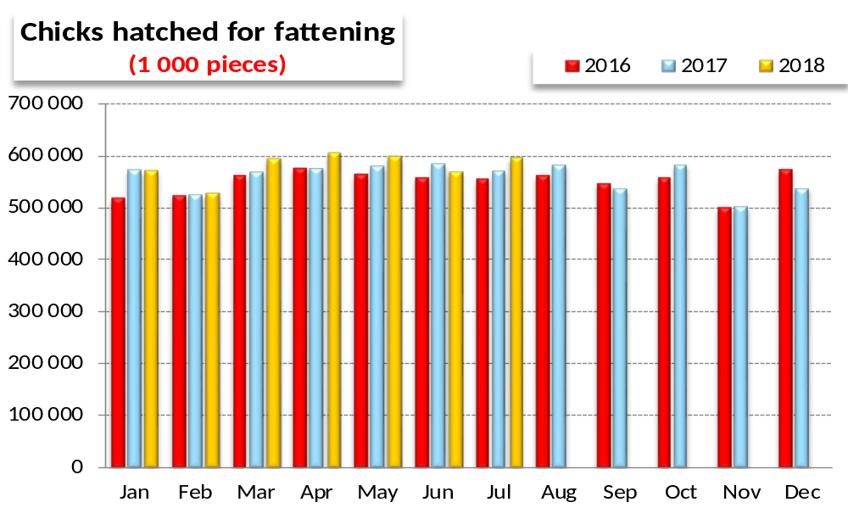
P R O D U C T I O N
NEW PARAMETERS

Slide 4
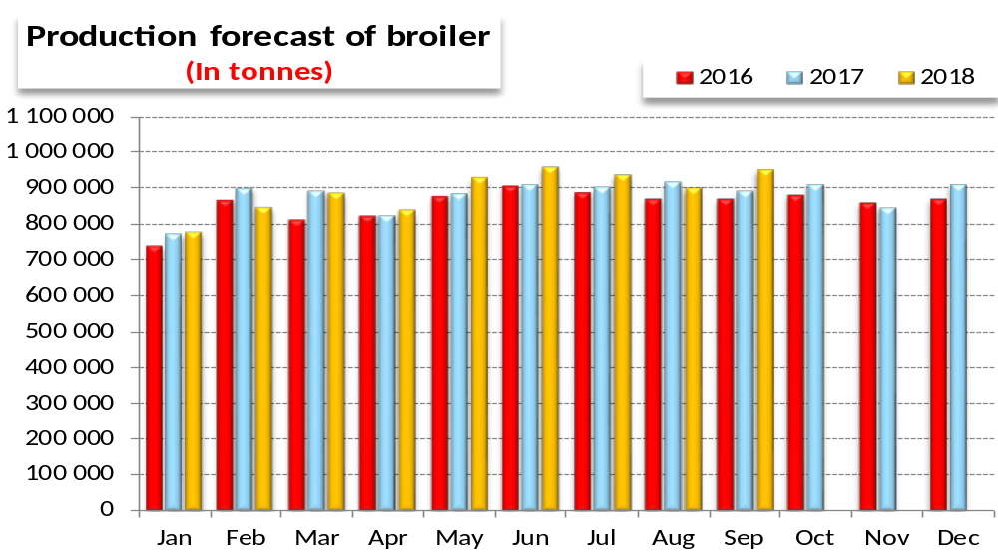
P R O D U C T I O N
NEW PARAMETERS

Slide 5
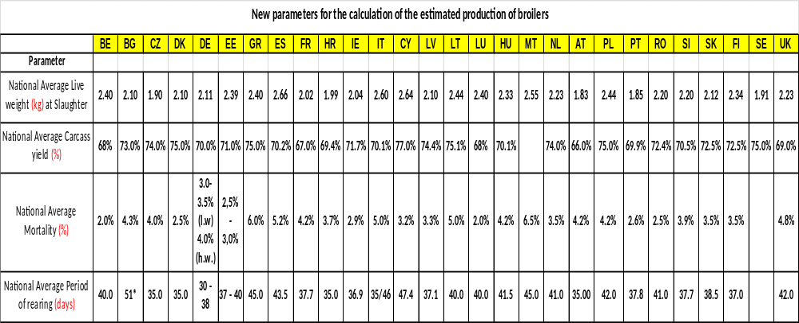
P R O D U C T I O N
NEW PARAMETERS

Slide 6
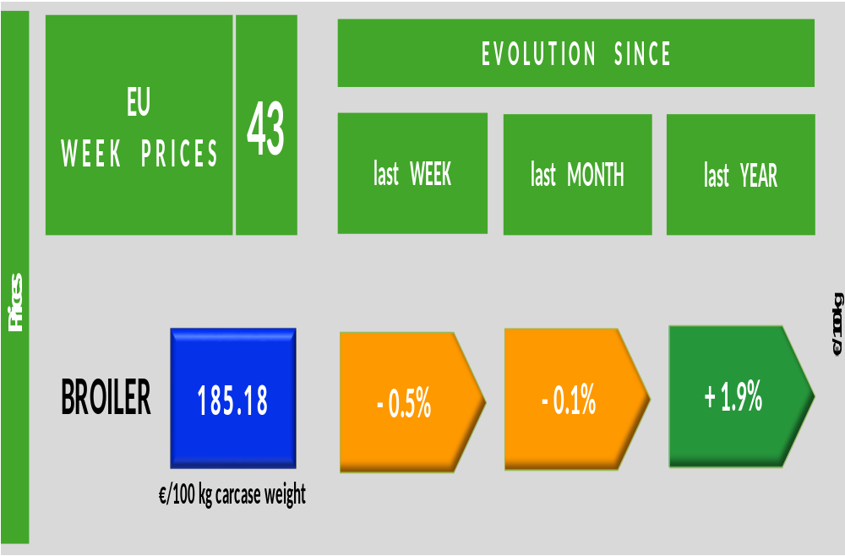
P R I C E S

Slide 7
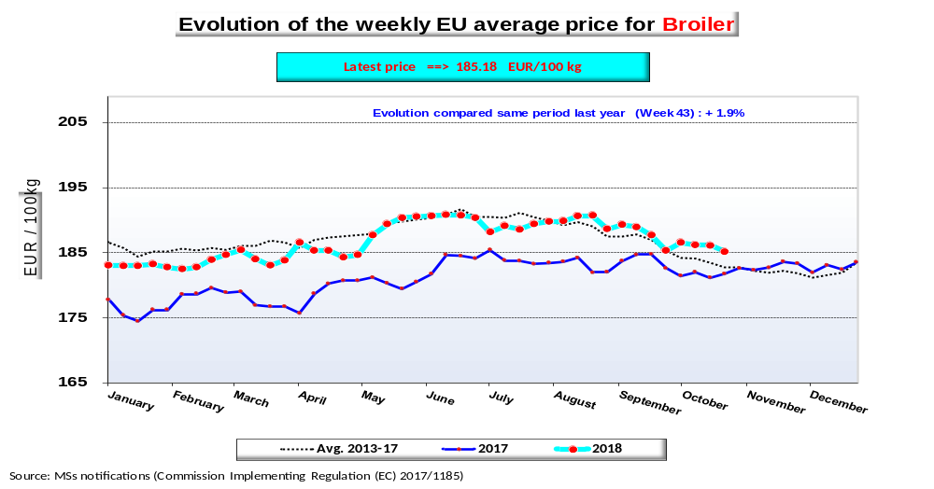
P R I C E S
E U E V O L U T I O N
B R O I L E R

Slide 8
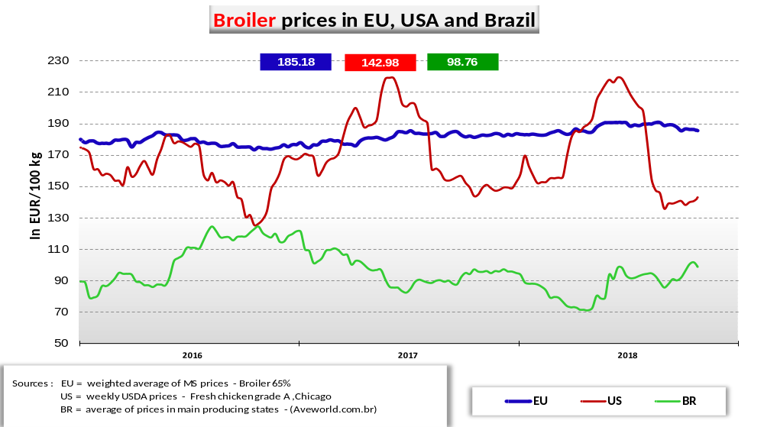
P R I C E S
E U E V O L U T I O N
B R O I L E R

Slide 9
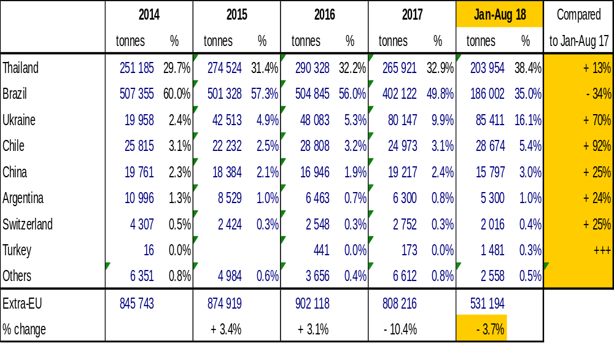
T R A D E
E U I M P O R T S
B r o i l e r P r o d u c t s
Imports of poultry meat from selected origins

Slide 10
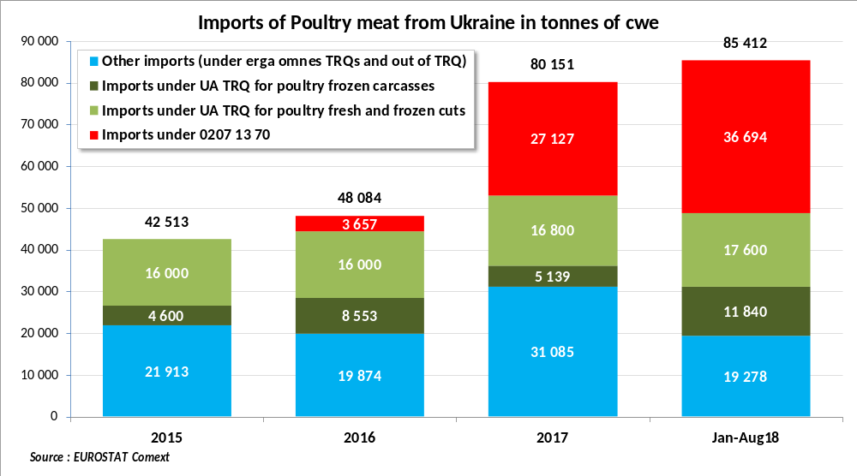
EU market situation for Poultry 8 November 2018

Slide 11
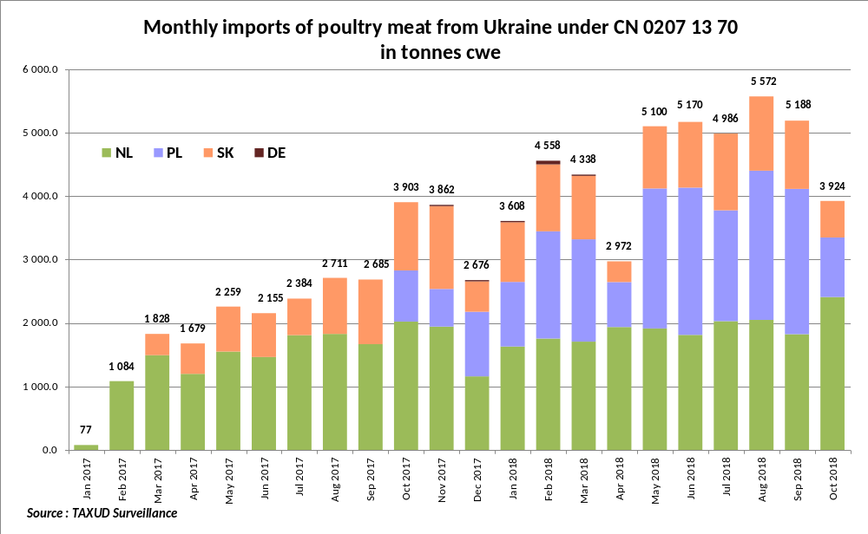

Slide 12
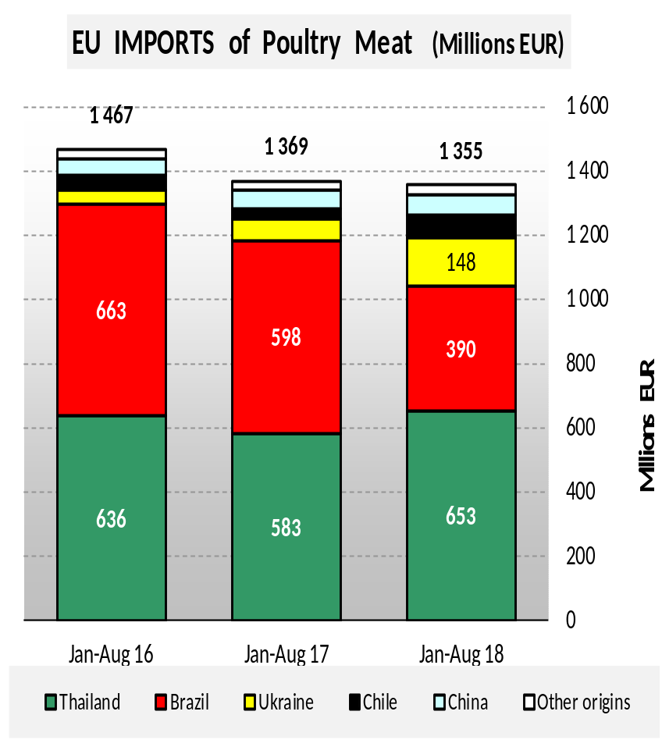
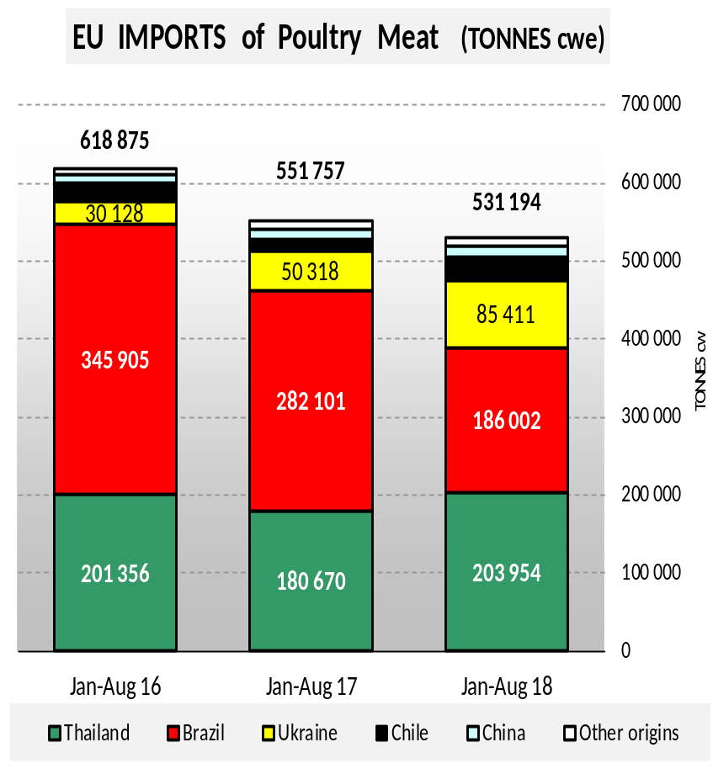
EU poultry meat imports
T R A D E
E U I M P O R T S
B r o i l e r

Slide 13
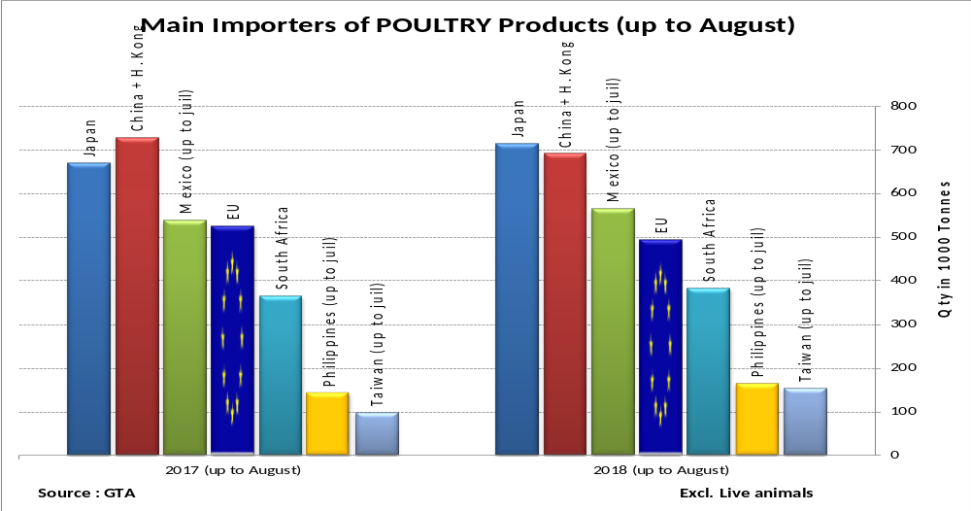
W O R L D
M A R K E T
E U I M P O R T S
BROILER MAIN IMPORTERS

Slide 14
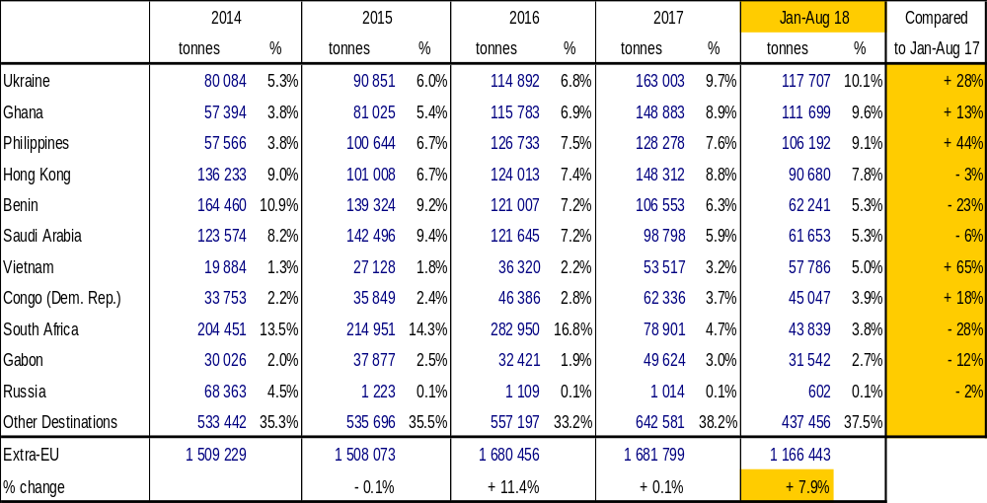
T R A D E
E U E X P O R T S
B r o i l e r P r o d u c t s
Exports of poultry meat to selected destinations

Slide 15
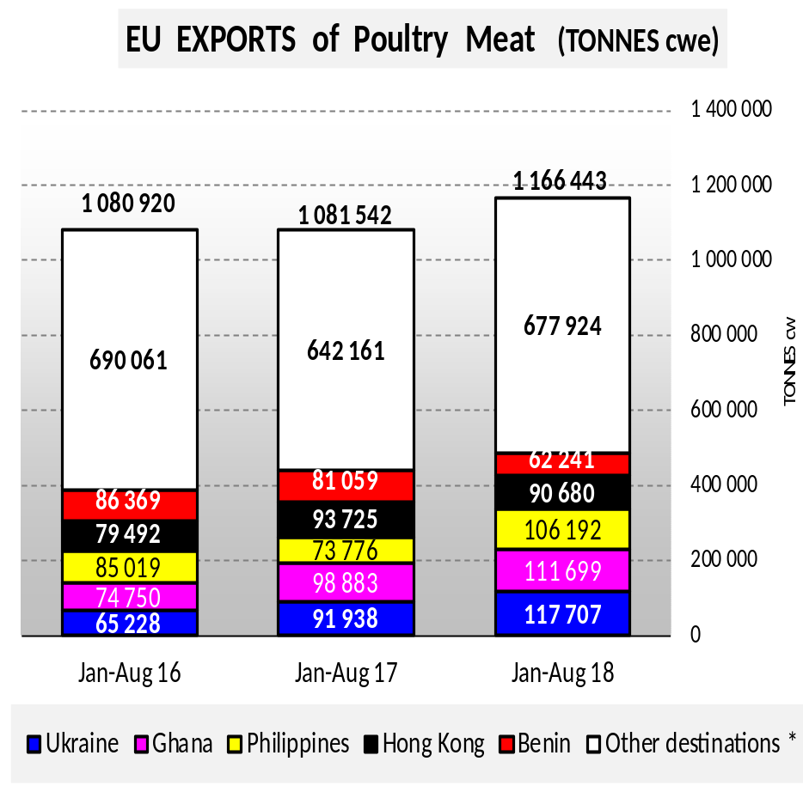
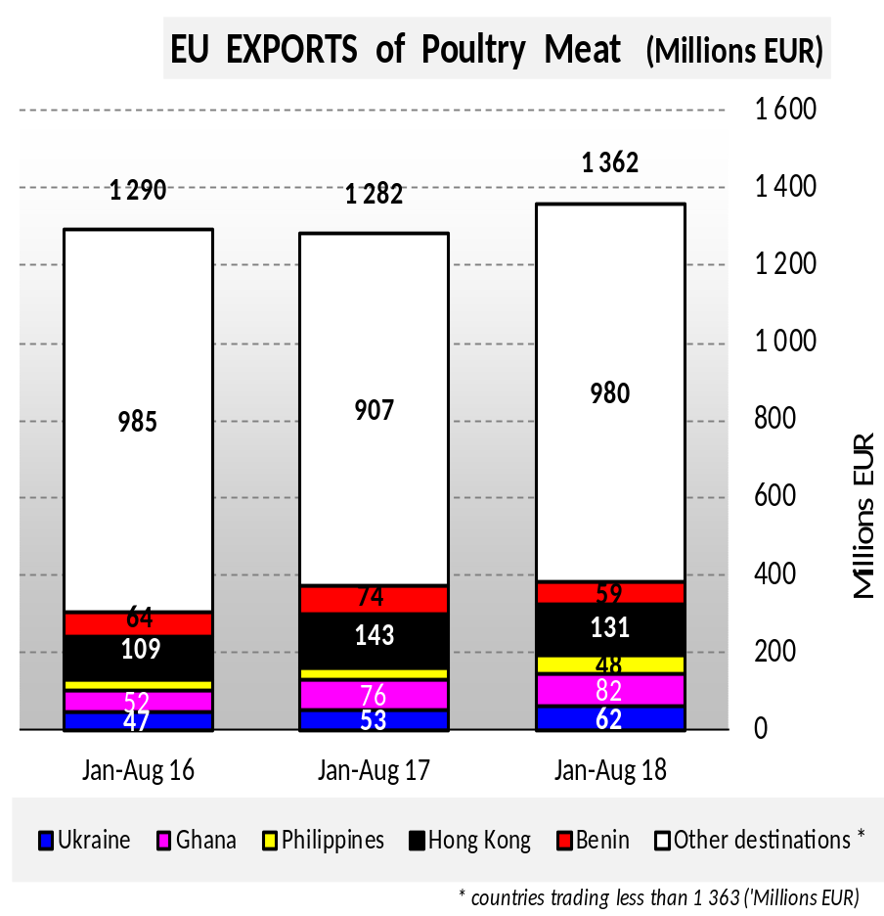
EU poultry meat export
T R A D E
E U E X P O R T S
B r o i l e r

Slide 16
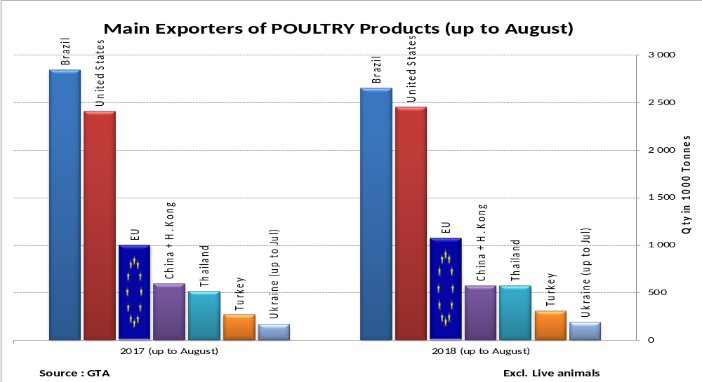
W O R L D
M A R K E T
E U E X P O R T S
BROILER MAIN EXPORTERS

Slide 17
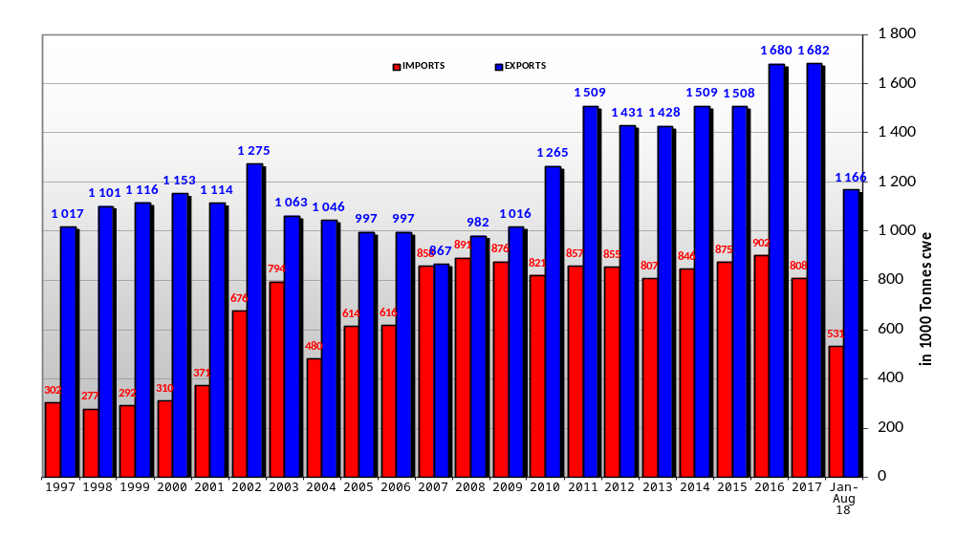
T R A D E B A L A N C E
EU poultry meat trade balance (in 1000 tonnes cwe)

Slide 18
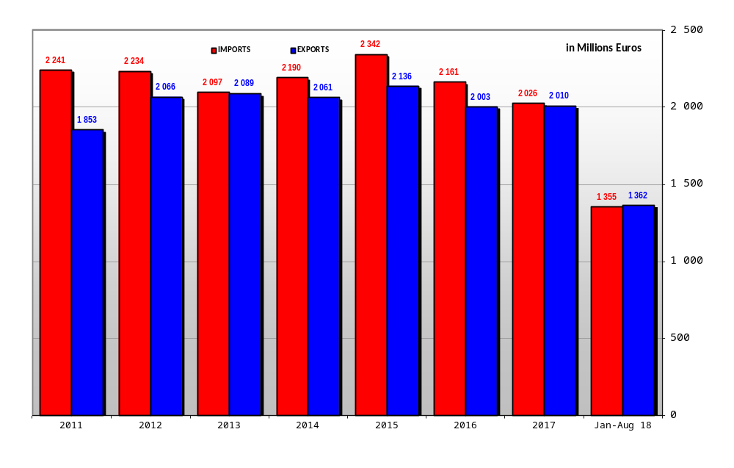
T R A D E B A L A N C E
EU poultry meat trade balance (in 1000 euros)

Slide 19
EUROPA SITE MARKETS
Where to find data:
http://ec.europa.eu/agriculture/markets/index_en.htm
Click on link: Poultry
Click on link: Presentations and prices
(righthand side under: in this chapter)
Choose the item (link) you want
Poultry dashboard
http://ec.europa.eu/agriculture/dashboards/poultry-meat-dashboard_en.pdf

